Slide 1
Global Warming and The Greenhouse Effect
Lab Rats: What is Global Warming, and what causes it?
Little Einsteins: What is the Greenhouse Effect?
The Atoms Family: Is the Greenhouse Effect good or bad, and why?
Space Blasters: What are the “greenhouse gases”, and where is the name coming from?
HD2: What are the strategies to slow down Global Warming?

Slide 2
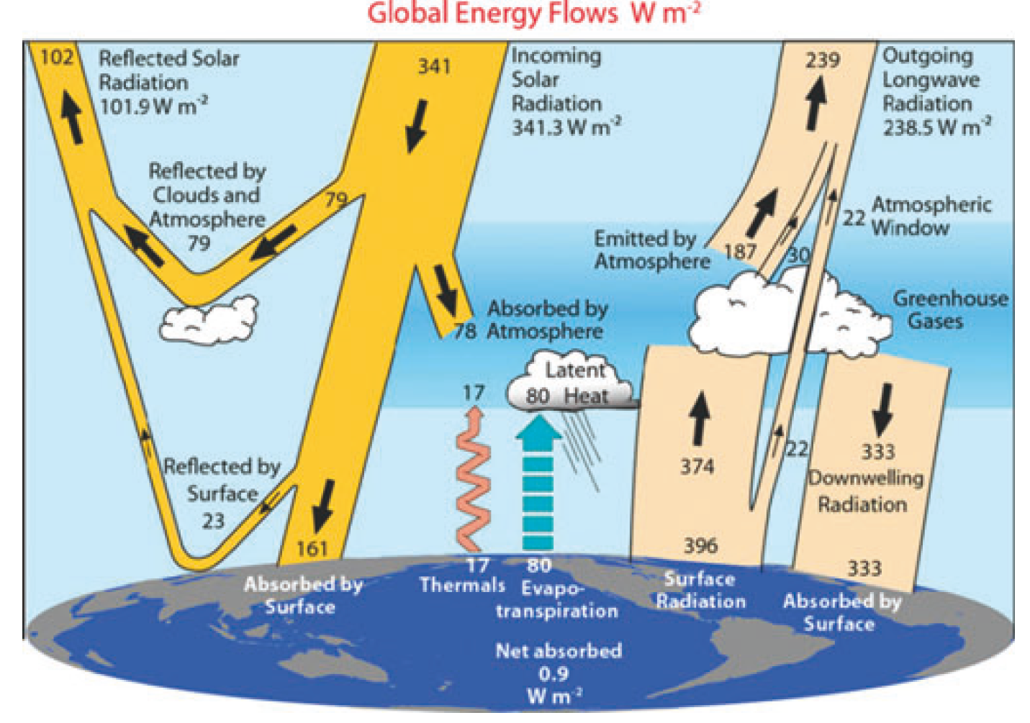
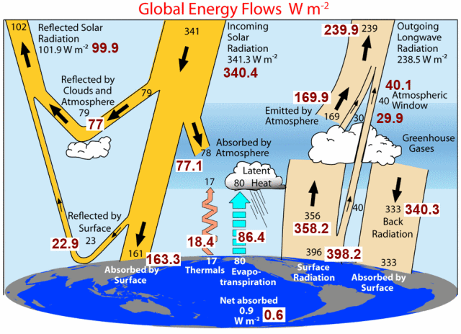
Earth's Global Energy Budget
NASA revises Earth's Radiation Budget, diminishing some of Trenberth's claims in the process
CO₂:
388.16ppm
397.31ppm

Slide 3
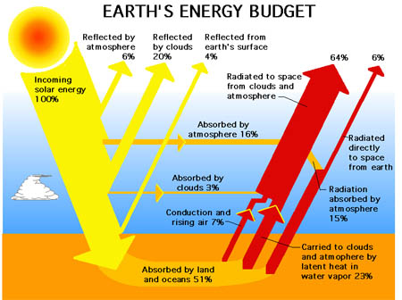
The Greenhouse Effect
https://wattsupwiththat.com/2011/10/26/does-the-trenberth-et-al-earths-energy-budget-diagram-contain-a-paradox/

Slide 4
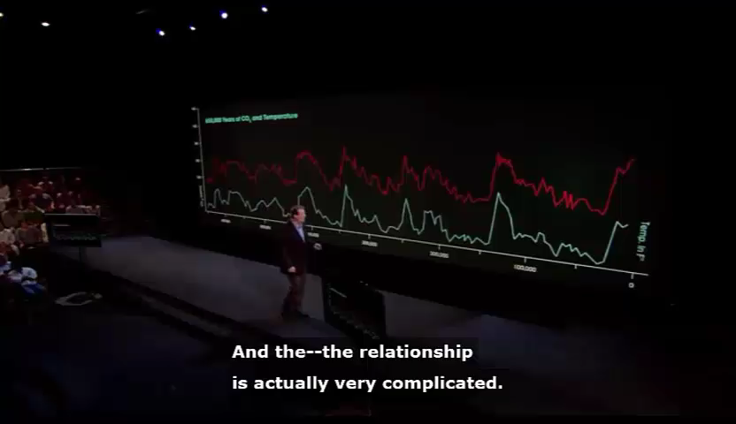
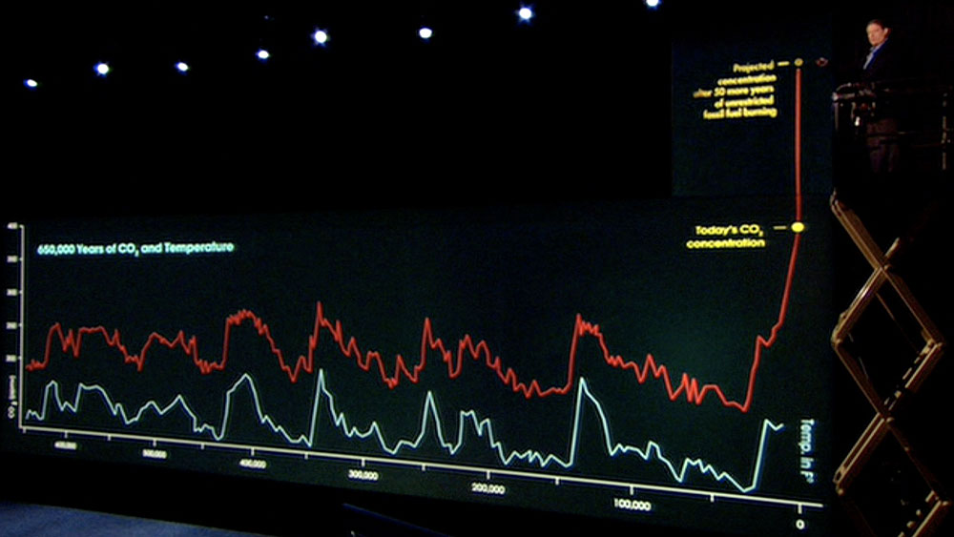
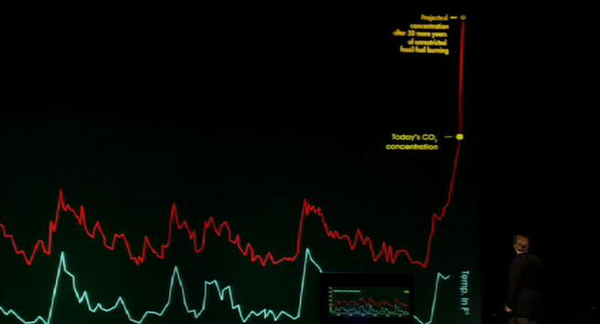
Al Gore: An Inconvenient Truth

Slide 5
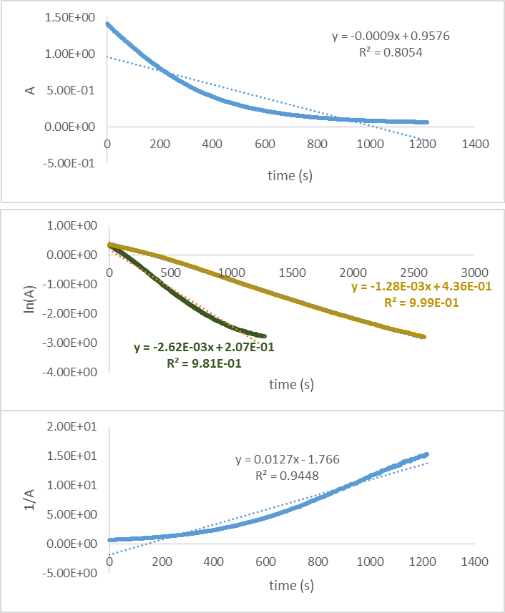
Regression Analysis
A measure how much two datasets are related
The closer it is to 1, the stronger the relationship is
0 < R² <1

Slide 6
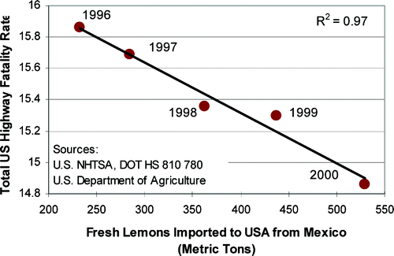
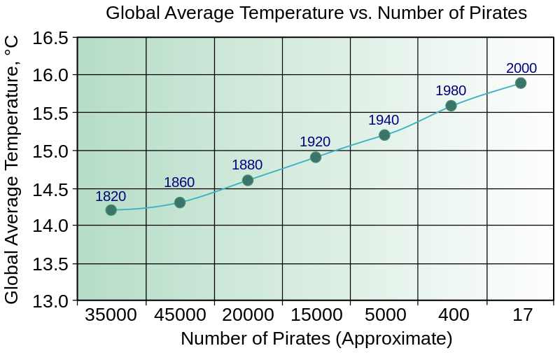
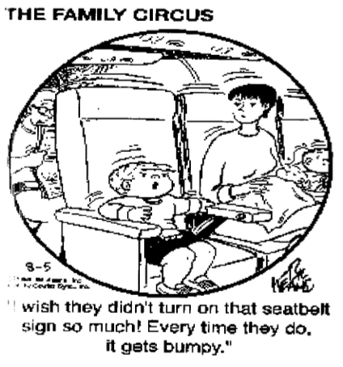

Correlation vs. Causation

Slide 7
CO₂ rises FIRST:
τ<0
time
time

Slide 8
Temperature rises FIRST:
τ>0
time
time

Slide 9
Temperature rises FIRST:
(τ>0)
Δt (K)
τ>0
time
CO2 conc. (ppm)
time

Slide 10
CO₂ rises FIRST:
(τ<0)
Δt (K)
τ<0
time
CO2 conc. (ppm)
time

Slide 11
Temperature vs. CO₂
Raising Temperature
Raising CO₂
Increasing rate of reactions yielding CO₂
Decreasing solubility of CO₂ in water

Slide 12
Henry’s Constant

Slide 13
Fossil Fuels vs. Global Warming
Number of cars: | 1.20E+09
Fuel efficiency: |  | 25 | mi/gal
Travelled distance/day: |  | 50 | mi
Daily fuel consumtion/car: |  | 2 | gal
 |  | 6.08 | kg
Energy content of fuel: |  | 4.00E+07 | J/kg
Daily energy released/car: |  | 2.43E+08 | J
Efficiency of combustion engine: |  | 0.4 |  |  | Solar radiation: | 1.40E+03 | J/m2/s
Daily heat dissipated/car: |  | 1.46E+08 | J |  | Radius of Earth: | 6371000 | m
Total daily heat dissipated: | 1.75E+17 | J/day |  |  | Surface of Earth: | 1.27516E+14 | m²
Total daily electricity produced: | 1.37E+18 | J/day |  |  | Surface of Earth exposed: | 6.37581E+13 | m²
Total daily energy dissipated: | 1.54E+18 | J/day |  |  | Length of 1 day: | 86400 | s
Total daily energy dissipated/Solar radiation: | 0.02003% |  |  |  | Daily Solar energy: | 7.71E+21 | J
Pertoleum reserves: | 7.40E+21 | J
Natural gas reserves: | 6.00E+21 | J
Coal reserves: | 2.60E+22 | J
Total fossil reserves: | 3.94E+22 | J
Fossil fuel availability: | 2.37E+04 | days
 | 64.96 | years

Slide 14
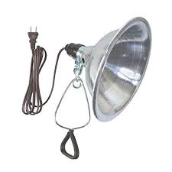


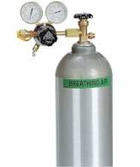

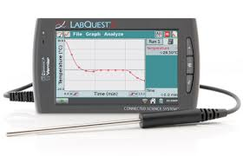

Is Carbon Dioxide a “Greenhouse Gas?
(a Scientific Method activity)
Design an experiment (“model”) with the given material that shows there is a Greenhouse Effect
Shows the effect of carbon dioxide on the Greenhouse Effect
Includes a control
Materials:
  Lamp with a stand
  Cups
  Plastic wrap
  Sand
  Carbon dioxide (in gas cylinder)
  Temperature sensor/LabQuest 2
Some questions to think about:
What can model confined air, the shielding effect of the “atmosphere”, the land that absorbs the energy, Sun?
What parameter (quantity) could be measured to show the Greenhouse effect?
How do you expect the measured quantity change in the control, in the different configurations showing the Greenhouse effect with and without carbon dioxide

Slide 15
Complete the Worksheet before you leave
Take the Worksheet with you to write a Report
Report is due one week from today
File the Report on BB and return the Worksheet in one week

Slide 16



Setup for Greenhouse Effect
Control
Plastic wrap over the opening
Open
Skewer
Temperature probe taped to the skewer
Sand

Slide 17
Bonus:
Control
2. Greenhouse effect over land
3. Greenhouse effect over land with CO₂ atmosphere
4. Greenhouse effect over water
CO₂

Slide 19
CO₂

