Slide 1
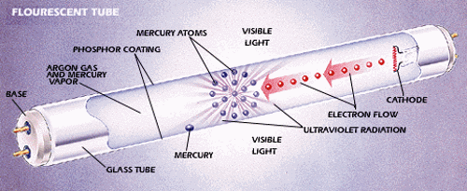
https://www.ideallighting.co.uk/2016/05/03/how-fluorescent-lamps-work/

Slide 2
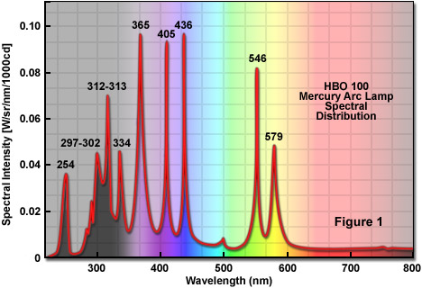
http://zeiss-campus.magnet.fsu.edu/articles/lightsources/images/mercurylampsfigure1.jpg

