Slide 1
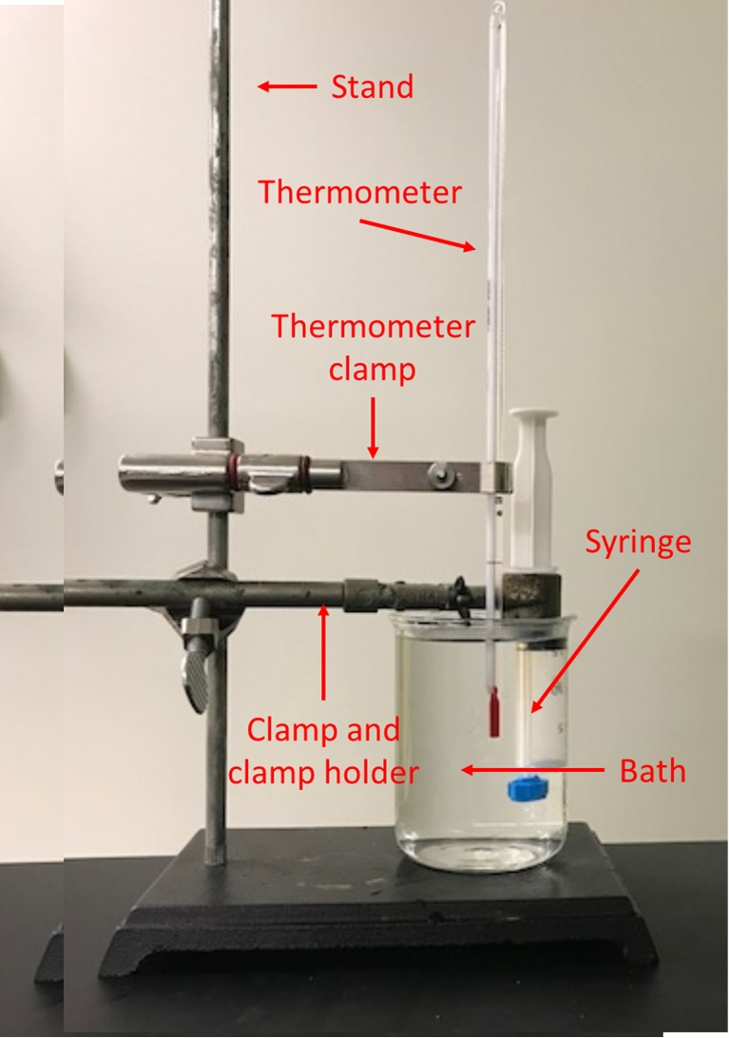
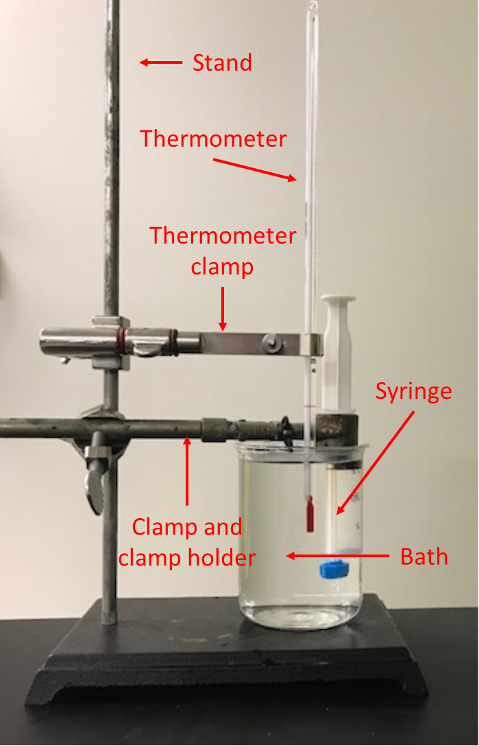
Stand
Thermometer
Thermometer
clamp
Syringe
Clamp and
clamp holder
Bath

Slide 2


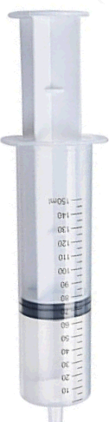


Ice+salt
(Beaker 1.)

