Slide 1
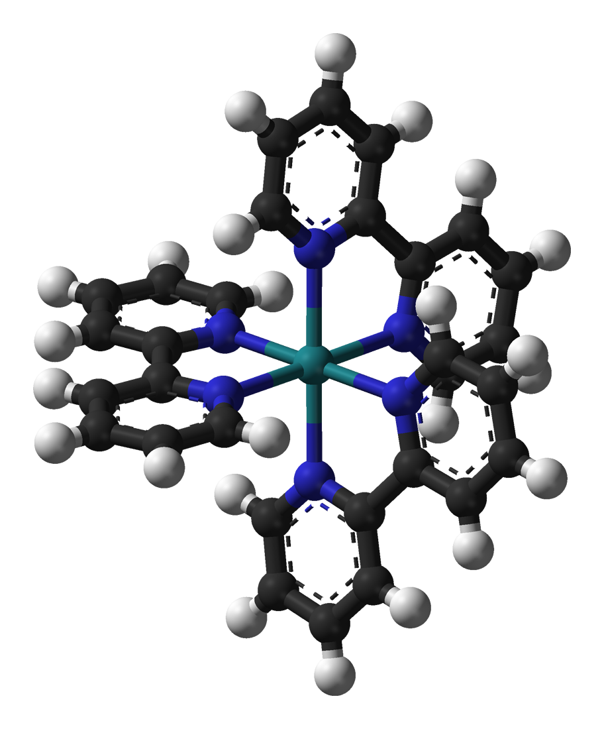
DETERMINATION OF THE RATE OF AN ELECTRON TRANSFER REACTION BY FLUORESCENCE SPECTROSCOPY
Presenter:Sandor Kadar, Ph.D.

Slide 2
Objective
to study the relationships among the absorption, fluorescence excitation, and fluorescence emission spectra of Ru(bipyridyl)₃²⁺,
to determine the rate of the electron transfer reaction between Ru(bipyridyl)₃²⁺ and Fe³⁺ or Cu²⁺ .
to learn the basics of Fluorescence spectroscopy

Slide 3
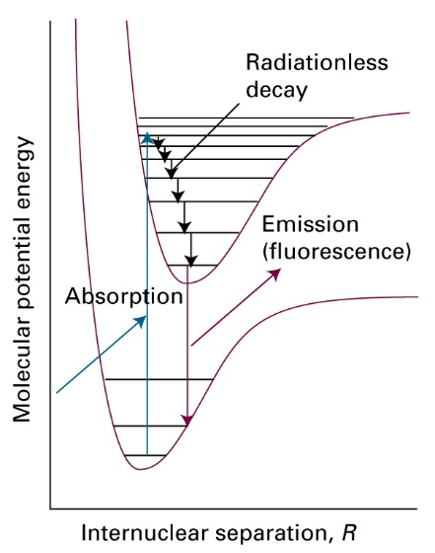
Background/Theory
Promotion to a excited electronic state via absorption of a photon
  Ground electronic state mostly populated on the lower vibrational levels
  Excitation can occur to multiple vibrational state of the excited electronic state
  ~10⁻¹⁵ s
  Very small internuclear effect (Frank-Condon principle)→ vertical transition
Relaxation through radiationless process
  Energy transfer as heat
  Interaction with surrounding (e.g. solvent molecules)
  ~10⁻¹² -10⁻¹⁵ s
Relaxation to the ground electronic state
  Photon emission (fluorescence)
  Quenching (interaction with other molecules)
Absorption/emission process

Slide 4
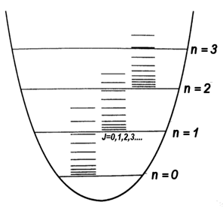
Fluorescence
Rotational/Vibrational transitions

Slide 6
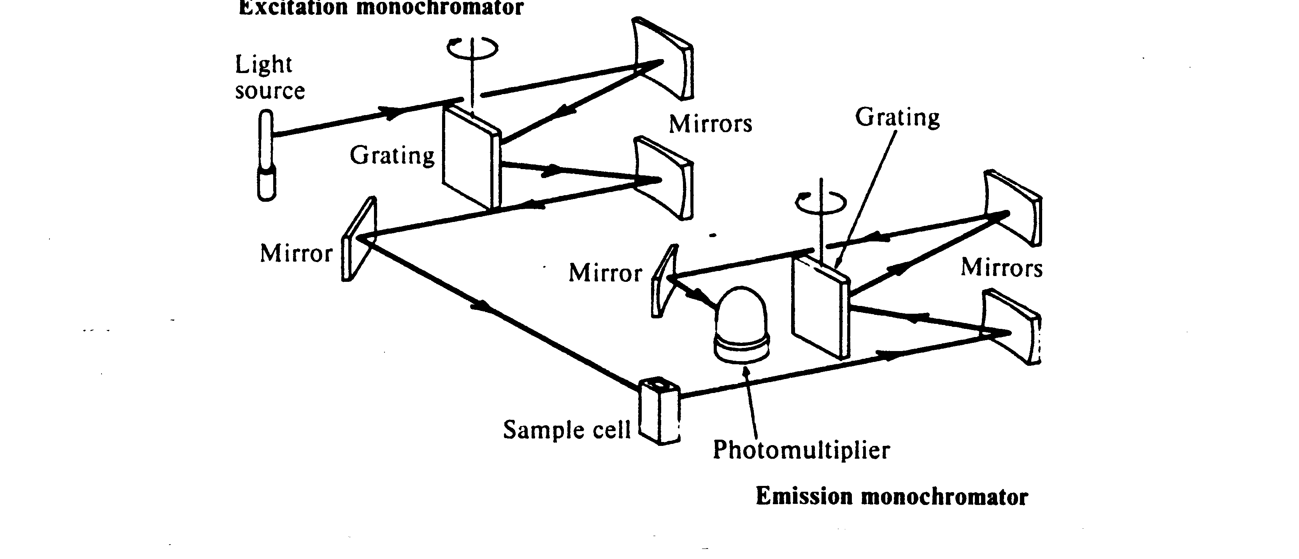
Fluorimeter
Monochromatic exiting beam
Perpendicular detector to exiting beam

Slide 7


Slide 8
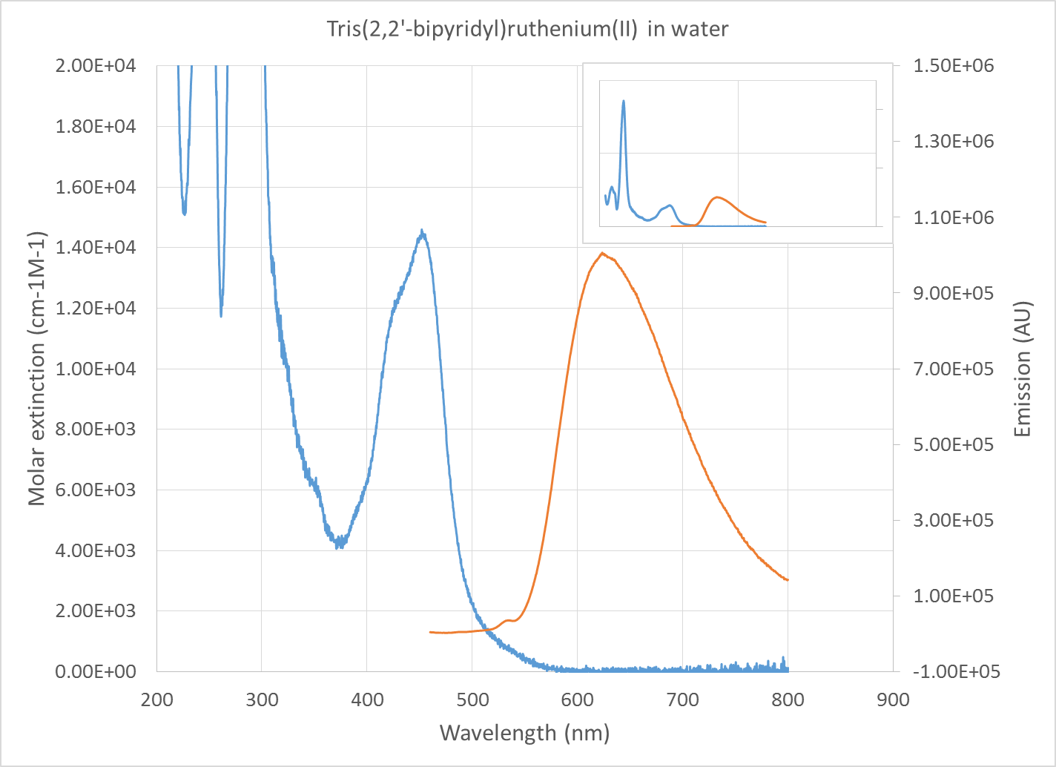
Background/Theory
Absorption/emission spectra
Emission maximum shifted to longer wavelength (lower energy) due to loss of energy via radiationless process(es) (Stokes shift)
“Semi-Mirror” nature of absorption and emission spectra
http://web.nmsu.edu/~snsm/classes/chem435/Lab6/

Slide 9
Background/Theory
Photochemical process
http://web.nmsu.edu/~snsm/classes/chem435/Lab6/

Slide 10



Background/Theory
Excitation:
$$R^{2+}+hυ\underset{→}{rate=r}{\left(R^{2+}\right)}^{∗}$$
$${\left(R^{2+}\right)}^{∗}\underset{→}{k_{s}}R^{2+}$$
Fluorescence:
$${\left(R^{2+}\right)}^{∗}+X^{n+}\underset{→}{{}_{k_{q}}}R^{3+}+X^{\left(n−1)+\right.}$$
Quenching(redox reaction):
y₀ = [(R²⁺)*] without a quencher species present
y = [(R²⁺)*] with a quencher species present
x = [Me^{n+}]
r = rate of excitation
I₀ = fluorescence intensity without a quencher
species present
I = fluorescence intensity with a quencher
species present
k_{s} =constant for the relaxation process
(fluorescence)
k_{q} =constant for the quenching process

Slide 13
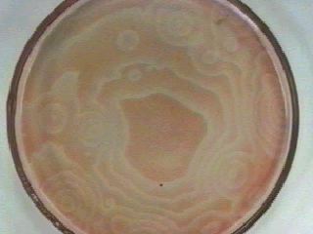
Background/Theory
2.5. About the Ru-complexes
Extensively used as a photosensitizer in solar energy conversion systems
Used for dye-sensitized photovoltaic devices
Photochemical reactions
  Photosensitive Belousov-Zhabotinski reaction: Ru(Bpy)₃²⁺+ Bromomalonic acid
  Chemical system used to model complex biological system (cardiac arrest → CHEM335)

Slide 14
Experimental procedure*
Step #1:
Prepare 0.500 L of a stock solution of 1.00 x 10⁻⁵ M Ru(bipyridyl)₃²⁺ in 0.5 M H₂SO₄.
Step #2:
Prepare 0.100 L stock solutions of 2 x 10⁻³ M Fe³⁺ (from FeCl₃•6H₂O) and 2 x 10⁻¹ M Cu²⁺ (from CuSO₄ or CuSO₄•5H₂O), using the Ru²⁺/H₂SO₄ solution prepared above as solvent.
Record the exact mass of the metal salts that are weighed so that you can determine the concentrations of the solutions to 3 significant figures.
*Note: Steps are numbered according to the handout

Slide 15
Step #3:
Use the solutions from the previous step to prepare the following sets of solutions, diluting all with the Ru²⁺/H₂SO₄ solution, in 15-mL tubes using autopipets.
Use the calculated volume of the stock solutions and add the calculated volume
of Ru(Bpy)₃²⁺ solvent
Calculate all concentrations to 3 significant figures based on the concentrations of your stock solutions to use in subsequent calculations:
[Fe³⁺] [Ru(bipyridyl)₃²⁺ ]
2.00 x 10⁻⁴ M ~10⁻⁵ M
4.00 x 10⁻⁴ M ~10⁻⁵ M
8.00 x 10⁻⁴ M ~10⁻⁵ M
1 .20x 10⁻³ M ~10⁻⁵ M
1.60 x 10⁻³ M ~10⁻⁵ M
1.80 x 10⁻³ M ~10⁻⁵ M
[Cu²⁺ ]
2.00 x 10⁻² M ~10⁻⁵ M
4.00 x 10⁻² M ~10⁻⁵ M
6.00 x 10⁻² M ~10⁻⁵ M
8.00 x 10⁻² M ~10⁻⁵ M
1.20 x 10⁻¹ M ~10⁻⁵ M
1.60 x 10⁻¹ M ~10⁻⁵ M
1.80 x 10⁻¹ M ~10⁻⁵ M
Step #4&5:
Obtain the absorption spectrum with the OceanOptics spectrophotometer and determine the wavelength of maximum absorbance (λ_{Abs})
Record the temperature around the fluorimeter

Slide 16
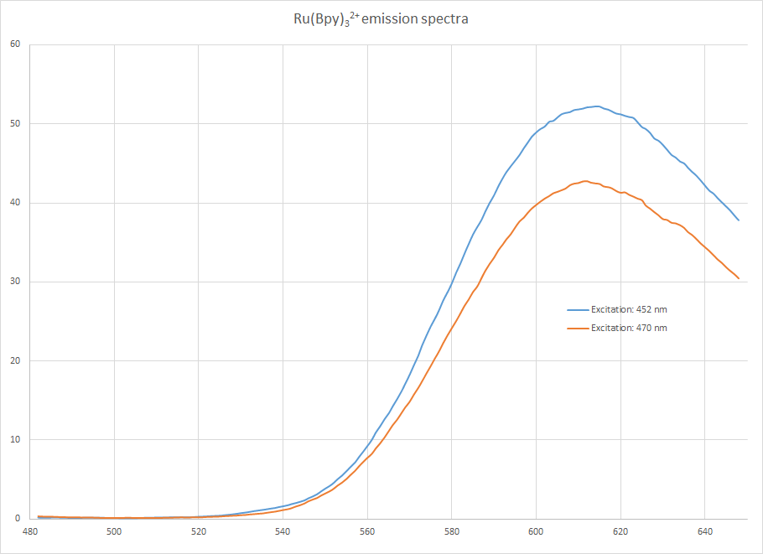
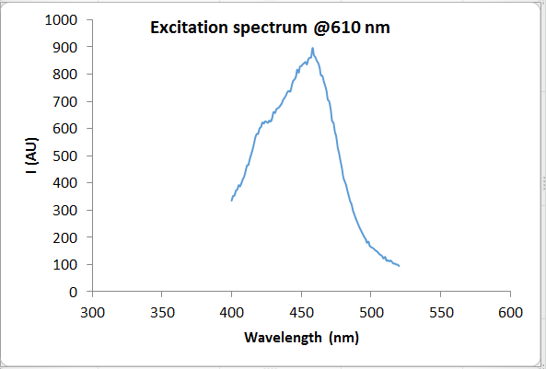
Absorption spectrum
Emission spectrum
Excitation spectrum
λ_{Abs}
Ex:λ _{Abs}
Em: 480-650 nm
λ_{Em}
λ_{Ex}
Ex:470 nm
Ex: 400-520 nm
Em: 480-650 nm
Em: λ_{Em}
Ex:λ_{Ex}
Em: 480-650 nm
Quenching experiments

Slide 17
Step #8:
Set the excitation (λ_{Ex}) and emission wavelength (λ_{Em} ) to the values that you determined before
Determine the fluorescence intensity of a fresh sample of the ~10⁻⁵ M Ru(bipyridyl)₃²⁺.(take three readings) before and after you ran the solutions with quencher (to check for reproducibility)
Determine the fluorescence intensity of all solutions prepared (take three readings for each solution)
Collect three spectra with 0.5 M H₂SO₄ solution as well

Slide 18
Calculations
Obtaining emission intensities
Calculate the average emission intensities from the three readings (six for the Ru(bipyridyl)₃²+ solution) for each solution
Subtract the average of the three H₂SO₄ spectra from each emission spectrum
Plot the I₀/I vs. x
Obtain the slope (k_{q}/k_{s}) for both, the Cu²⁺ and Fe³⁺ dataset
Calculate k_{s} from the table provided
J.E. Baggott, M.J. Pilling, J. Phys. Chem. 84., 3012-3019 (1980)

Slide 19
Some questions
Did you get the same emission spectrum with excitation λ_{Abs} (obtained from the absorption spectrum) and λ_{Ex} =470 nm? If not, what is the difference between them and what do you think the reason is for the difference (Hint: Consider how the excitation and relaxation occurs in terms of the energy levels)
How is the emission spectrum different, if at all, if a range of photons are used instead of just a single wavelength for excitation? Does the structure of the emission spectrum change? Do the peak intensities change? Why (Hint: In either configuration, what limits how many excitation can occur)?
Do the quenching rate constants for Cu²⁺ and Fe³⁺ significantly differ? If so, why? Compare your results to the values in the table provided.
Compare your results with literature values:
  http://www3.nd.edu/~ndrlrcdc/Compilations/Quench/RX1_130.htm
  http://www3.nd.edu/~ndrlrcdc/Compilations/Quench/RX1_112.htm

Slide 20
Safety
Ru²⁺, Fe³⁺, and Cu²⁺ solutions are considered heavy metal waste and have to be disposed of accordingly
Use gloves.
Sulfuric acid: remember to add acid to water slowly and not the other way around. If your skin is exposed to sulfuric acid, use running water to wash it off.
Remember where the safety equipment (eye wash station, shower, etc.) is
Observe the general safety rules that your professor set for the lab!

